Slide 1

CS1951 L
Blockchains & Cryptocurrencies
Fall 2025
Lecture 2
Bitcoin
Maurice Herlihy
Brown University

Slide 2
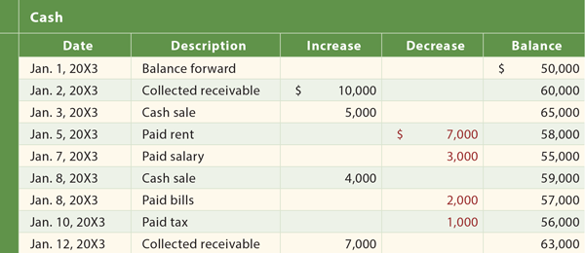
Abstraction: Distributed Ledger
Append-only list of events
Not just financial
Everyone agrees on content
Tamper-proof!
Notes:
Just a quick review. Do not lose sight of the fact we are ultimately implementing a ledger, CLICK an append-only list of events, CLICK which need not be restricted to financial transactions CLICK, and whose contents are unambiguous CLICK and of course, tamper-proof

Slide 3






Clients ….
Miners …
Notes:
Blockchains such as bitcoin have several kinds of Roles. Clients are the chain’s customers, they want to get things done. Miners decide which client transactions make it into the ledger, and in what order.

Slide 4
Clients ….
send transactions …
to miners.
Notes:
Client send transactions CLICK , shown here as stars, to miners CLICK

Slide 5
Miner batches transactions in blocks
Notes:
For efficiency, the miners batch transactions into blocks (this is where the block in blockchain comes from)

Slide 6
Miners …
do consensus to pick one block …
Notes:
The miners assemble competing blocks, and now they must agree on which block is the next one to go on the blockchain. CLICK. They do this by running a consensus protocol

Slide 7

Chain Property
Control x% of miners, get to choose x% of blocks
Not always true but close enough
Notes:
http://safeact.com.au/wp-content/uploads/2014/01/safety.png
There’s a security issue here: in principle, if one party controls x% of the miners, they should control x% of the blocks, roughly speaking. This speaks to the issue of decentralization: if mining is decentralized (the ideal) then so is control over the blockchain’s content. Beware however that the converse is also true: if most of the mining is under the control of a small number of parties, decentralizes suffers.

Slide 8

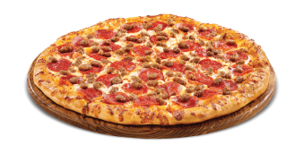

Problem: Double Spending
dbea25daf536
dbea25daf536
Notes:
Researchers were working on electronic money long before bitcoin. The problem that always eluded earlier efforts was the problem of double spending. Here we see one client, the orange chip, using the same bitcoin to order a double tall caramel latta and a pepperoni pizza. The merchants individually think they are being paid, but it will all end in tears.

Slide 9

Old-School Solution
mint
dbea25daf536
eff3887207be
Notes:
Early attempts at digital money solved the double spending problem in a centralized way: by introducing a kind of central database, called the mint, that tracks coin ownership. This prevents double spending, but it is highly centralized, and subject to censorship, not fault-tolerant etc.

Slide 10
Nakamoto Solution
Public
ledger
dbea25daf536
dbea25daf536
Notes:
Nakomot’s key insight was to replace the centralized mint with a public distributed ledger. If someone offers you a bitcoin for a pizza, you can go through the ledger to make sure you are the only party with a claim to that coin.

Slide 11
Nakamoto Solution
Public
ledger
dbea25daf536
dbea25daf536
Notes:
Quoting from the Nakamoto paper, transactions are publicly announced, their order is unambiguous in the sense that all participants eventually agree on what happened when

Slide 12

Liveness
Decide nothing?
Trivially safe
Want to guarantee that good things happen
Notes:
When you describe what a distributed system is supposed to do, it is helpful to split properties into safety properties, nothing bad happens, and liveness properties, some thing good happens. CLICK It is always safe to do nothing, CLICK but we will need to pay attention to the kinds of CLICK liveness guarantees the chain makes.

Slide 13
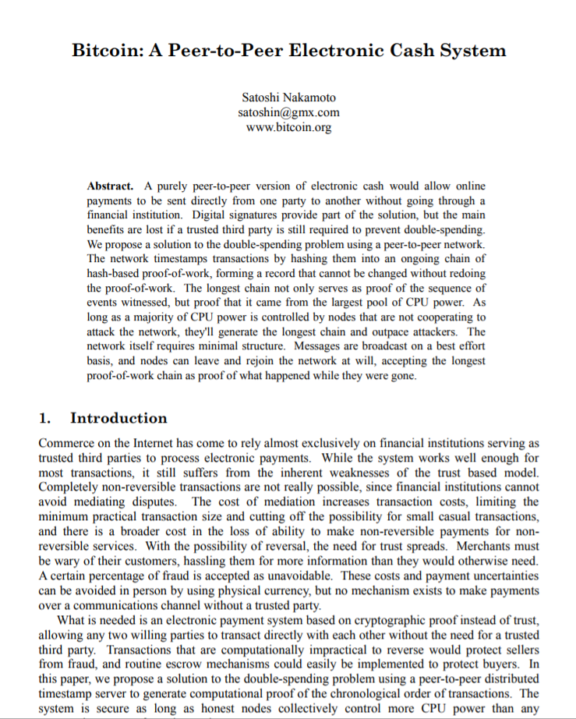
Illustrate ideas using quotes & diagrams from the original paper
Notes:
Bitcoin, Ethereum, ICOs, blockchains, etc. are the result of a single paper (and running code) that appeared mysteriously in 2008. I am going to claim it’s all about distributed computing, but it did not come from the distributed computing research community. I feel confident speculating that if this paper had been submitted to PODC in 2008, it would have been rejected for defining consensus weirdly, or not proving any lemmas, or not providing experiments. Yet here we are, looking at a new, vibrant, and active area of CS. What are we to make of it?

Slide 14
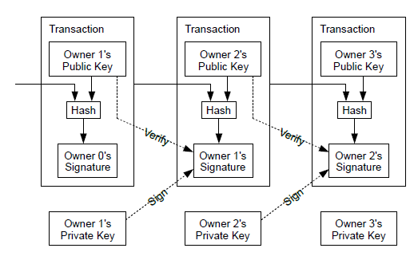
How it works
Notes:
Here is a diagram showing Nakamoto’s original schematic. These are individual transactions (payments), not blocks.

Slide 15
New owner’s identity
How it works
Tamper-proofing
Old owner’s signature
Notes:
To make transactions tamper-proof, CLICK the source of a payment provides the public key of the new owner: “this is who gets my coin”. CLICK The old owner then signs the transaction, proving that it’s authorized. CLICK finally the transaction and predecessor transactions are hashed together to make the whole thing tamperproof.

Slide 16
Every node keeps a copy of every transaction
(except maybe SPV nodes, later)
Widely considered reckless at the time
Still a scalability issue
Notes:
To make transactions accessible to clients, every node keeps a copy of every transaction. Light-weight nodes CLICK like one that runs ae your phone are an exception. At the time this was viewed as crazy wasteful, maybe because it is, and

Slide 17
Nakamoto Consensus in One Line
hash of last block on longest
branch
public
key
difficulty
SHA256( h | T | K | nonce ) < D
standard
hash
function
transactions
Find this!
Notes:
Here is a one-line forumulation of how Nakamoto consensus works. It's all here. start with a standard cryptographic hash function. CLICK. To link the new block to the rest of the chain, we take the hash of the block we want to build on. CLICK Then we concatenate the transactions we want to put on the block (actually the hash of those transactions, but never mind.) CLICK We add the public key of the party who should get the coinbase, that is new block, reward CLICK and we want the entire hash to be smaller than a difficulty threshold (that is, it should have lots and lots of leading zeros). CLICK Finally, the goal is find a string, called a nonce, that makes this all happen.

Slide 18
Nakamoto Consensus in One Line
SHA256( h | T | K | nonce ) < D
No formal proof of collision-resistance
Possible quantum attacks?
Other chains use similar hashes
Notes:
Let's go over this again. Bitcoin uses the standard SHA256 hash function. So far, there is no proof that this function is collision-resistent, but everyone believes it is. Of course, if you discover it isn't, you could become very rich, and you probably wouldn't tell. Also, it seems plausible that if quantum computing ever becomes a thing, this hash function could be vulnerable. Other PoW chains use similar hashes, but not always this one.

Slide 19
Nakamoto Consensus in One Line
SHA256( h | T | K | nonce ) < D
Tamper-proofing
Key in key-value store
Notes:
As we will discuss later on, each Bitcoin node uses a DB to track blocks and their hashes.

Slide 20
Nakamoto Consensus in One Line
SHA256( h | T | K | nonce ) < D
Actually hash of txn “Merkel tree” root
Constant size
Too expensive to hash txns themselves
Notes:
We don't actually hash the transactions themselves, instead we store transactions in a tamper-resistent data structure called a Merkle tree, and we hash the constant-sized tree root.

Slide 21
Nakamoto Consensus in One Line
SHA256( h | T | K | nonce ) < D
Pay “coinbase” reward to this address
Notes:
Simplifying somewhat, the miner that solves the puzzle collects a "coinbase" reward. This key is also a bitcoin address saying which miner should get that reward. Notice that you could put any address in there.

Slide 22
Nakamoto Consensus in One Line
SHA256( h | T | K | nonce ) < D
Too easy? frequent forks, slow finality
Too hard? low throughput
Adjusted dynamically: ~1 block / 10 min
Notes:
The difficulty level is tricky. If solving the puzzle is too easy, then there will be too many simultaneous solutions, resulting in forks, which means it will take too long to figure out if a block is final. CLICK If it is too hard, then it will take too long to add new blocks. CLICK Bitcoin uses a "Goldilocks" approach: it dynamically adjusts the difficulty so that miners add new blocks at a constant rate, about once every 10 minutes. The important point here is that bitcoin is slow as a design choice.

Slide 23
Nakamoto Consensus in One Line
SHA256( h | T | K | nonce ) < D
Just keep trying one after another …
Notes:
How do miners find the magic value that solves the puzzle? Brute force. Because the hash function is collision resistent (AFA we know), there is no alternative. While most distributed systems work hard to eliminate delays and inefficiencies, blockchains rely on them.

Slide 24
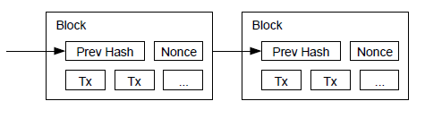
Find a value to put here …
To give this hash k leading 0s

Slide 25
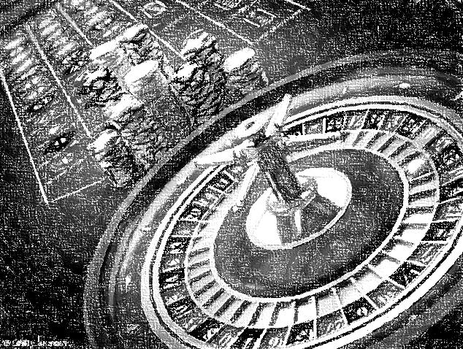
“Proof-of-Work” arguably a misnomer
Randomization is important
Otherwise, most computational power always wins
Instead, chance of winning is proportional to power
Still, danger of capture by big miners
Notes:
There are some subtle points here. CLICK Find a solution occurs at random, which matters because if the miner with the most hashing power always wins, then the chain would be centralized. CLICK Instead, your chance of winning is proportional to your hashing power. CLICK Still, you can see the danger: the more mining power you have the higher the probability you can control the ledger.

Slide 26
Questions?

Slide 27
Longest Chain Rule
Honest miners build on longest chain …
… longest chain reflects decisions of honest miners
Dishonest miners would have to out-compute all honest miners
Notes:
As we noted, simultaneous puzzle solutins cause forks --- the chain is actually a tree. Miners are supposed to build on the longest chain. CLICK Conversely, the longest chain should reflect the decisions of thehonest miners. CLICK To overturn the honest miners' decision, the dishonest miners would have to out-compute the honest ones.

Slide 28
Limited Throughput is Feature, not Bug
Number of blocks/time kept approximately constant
By varying PoW difficulty
This will become a problem as Bitcoin becomes successful

Slide 29
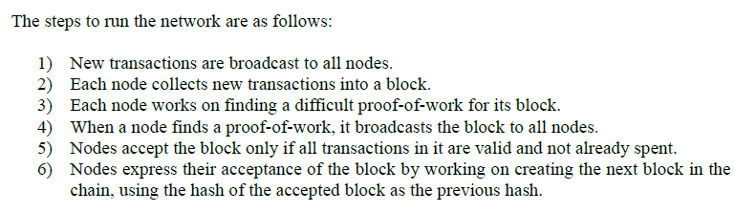
Notes:
Here is Nakamoto’s list of steps.

Slide 30
On the Bitcoin P2P layer
Clients send transactions to miners
Rumor: mining cartels use faster side-channels
Notes:
First, clients send transactions to miners. Please put my transaction in the ledger. CLICK Bitcoin encompasses a low-level peer-to-peer layer that propagates tranactions through the network of miners. CLICK Some people believe that mining cartels, organized groups of miners, use private faster out-of-band neworks to distribute transactions with high fees among themeselves.

Slide 31
Miners assemble transactions into blocks
Economy of scale: single transaction too expensive
Block size becomes major headache later on!
Notes:
Miners assemble blocks from these transactions. CLICK This isn't logically necessary: miners could add single transactions, but that would be inefficient. CLICK The "block-size" question of how many transactions fit in a block will become the source if inter-bitcoin civil wars later on.

Slide 32
Miners race to do Proof of Work
Today, consumes lots of energy
Cartels with access to cheap power and ASICs control most of hashing power
Notes:
Miners compete to solve the puzzle. Today, solving these puzzles take an insane amount of energy, and a scheme originally intended to promote decentralized has to some degree, done the opposite.

Slide 33
If multiple winners at the same time …
the blockchain forks …
Result: high latency because need to wait until your transaction deep enough in chain
Notes:
As we noted, multiple miners can solve the puzzle at the

Slide 34
Sanity check: malformed txns rejected
Incentive for miners to behave …
Notes:
Miners do sanity checks to make sure transactions are well-formed and not double spending. They won’t build on blocks with malformed transactions, which provides miners with an incentive to behave

Slide 35
Successors build on recent well-formed blocks
Pick longest chain if there is a fork
Break ties arbitrarily

Slide 36
Where’s my Money?
You mine a block, you get paid
How new bitcoins are generated
“Coinbase” transaction
Notes:
The first transaction to mine a block earns a “coinbase” reward, which is the only way new bitcoins are made. You don’t get this reward until enough other miners have endorsed your block by building on it.

Slide 37

Where’s my Money?
Clients can include transaction fee
Like a tip, to get prompt attention
This will become complicated …
Notes:
You can also collect “tips” from clients. When stuffing a block full of transactions, a miner will choose the ones with the largest fees, so volunteering a higher fee will speed up your transaction.

Slide 38
Deflationary
Limit on number of BTC ever minted
Fear of inflation?
But not deflation?
Eventually, only fees matter …
Notes:
Over time, the coinbase reward shrinks, until eventually miner’s only reward comes from fees. This means no more bitcoin are being created, and the supply will be forever fixed. This policy decision comes from an extreme fear of inflation. There are many interesting and unsettled questions about whether deflation has its own dangers

Slide 39
Crime doesn’t Pay
Suppose dishonest party acquires lots of hashing power …
Unlimited double spending?
Or collect all the rewards?
Vandalism destroys coin values!
39
Notes:
What happens if some evildoer acquires a majority of the hashing power? Perhaps by renting lots of mining hardware for a few hours? In principle, they could go on a double spending spree, or collect all mining rewards. Paradoxically, however, they would have little economic incentive to do so, since the value of bitcoin would crash.

Slide 40
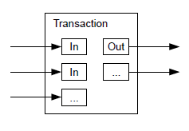
UTXO Model
Notes:
Bitcoin is not loke a bank, where you keep a balance in an account. It is more like a suitcase full of banknotes. A transaction in bitcoin is called a UTXO Uspent Transaction Output,

Slide 41
UTXO Model
A txn can have multiple inputs …
Notes:
It can have multiple inputs: the people in your book club pitch in for pizza

Slide 42
UTXO Model
… and multiple outputs
Notes:
Let’s say the inputs add up to $20 and the pizza is $15, so one txn output is $15 sent to the pizza store’s address, and the other is $5 change returned to the club

Slide 43
UTXO Model
pizza order
change

Slide 44
UTXO Model
Can also place other conditions on transfer …
smart contracts
Notes:
There is a scripting language that allows you to put other restrictions on how the money is spent, like restrictions on time, the number of signatures, etc. These scripts are sometimes called smart contracts. Bitcoin has a fairly rudimentary scheme but we will see more sophisticated schemes later when we study Ethereum.

Slide 45
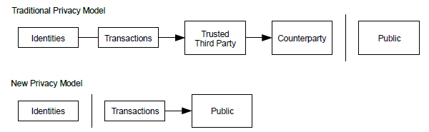
Privacy
Old-school: Trusted 3rd party keeps IDs secret
Notes:
What about privacy? Bitcoin originally advertised itself as privacy-protecting, but we will see later that bitcoin txns are pretty easy to trace. In a banking system, you trust the bank to keep your id secret

Slide 46
Privacy
Bitcoin: all transactions visible
Public sees only keys
Which can still leak information
“pseudonymous”
Notes:
In bitcoin, all txns are visibile (which is good for the FBI) but identities are replaced by addresses (keys). This is called “pseudonymous”, and is not very strong protection.

Slide 47
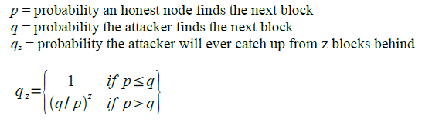
Calculation
Back of the envelope calculation
How likely dishonest miner can overtake honest miner to reverse transaction?
Exponentially small in gap size
Calculation naïve but probably mostly right

Slide 48
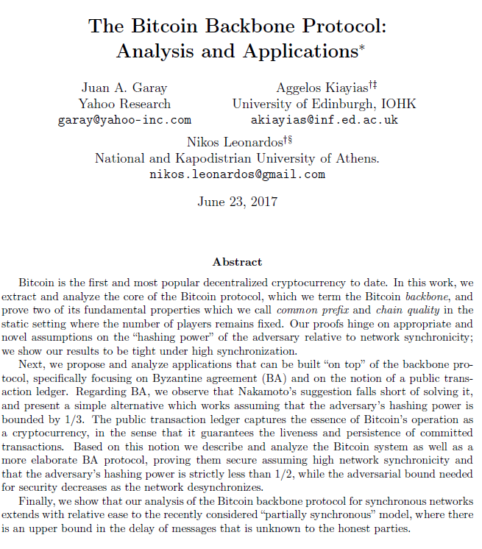
Here is a more complete calculation …
Lots of Chernoff bounds …
more precise statements of correctness
more precise bounds on hashing power

Slide 49
PoW and decentralization

Slide 50
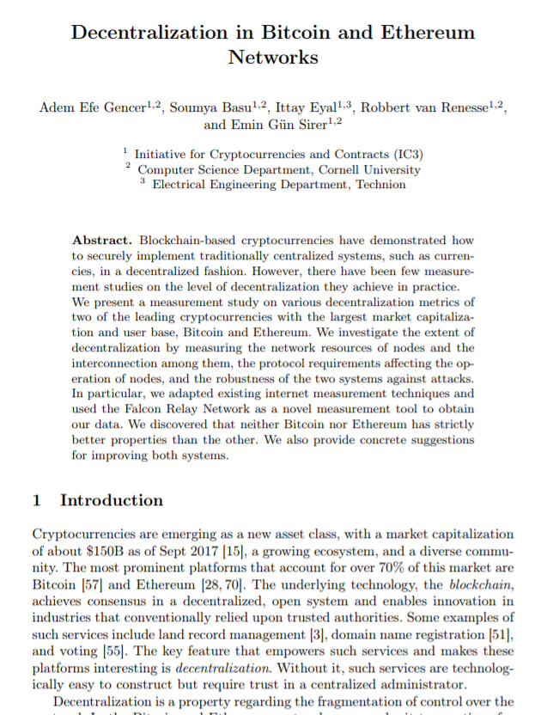
Beware of Fake Decentralization
Bitcoin is pretty centralized
Top 4 Bitcoin Miners > 53% power
15 Bitcoin, 11 Ethereum miners > 90%
Ethereum status ambiguous

Slide 51
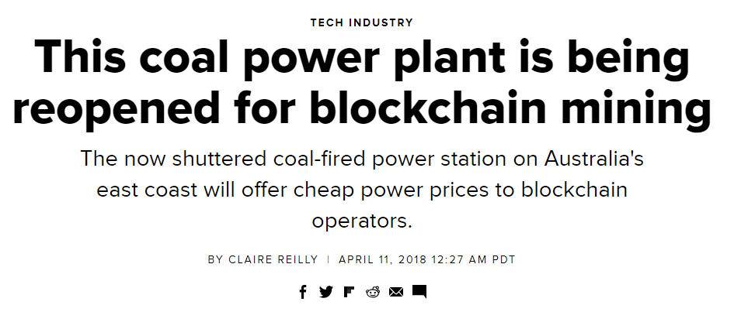
PoW Encourages Centralization
Power to the people …
who live near cheap energy?

Slide 52
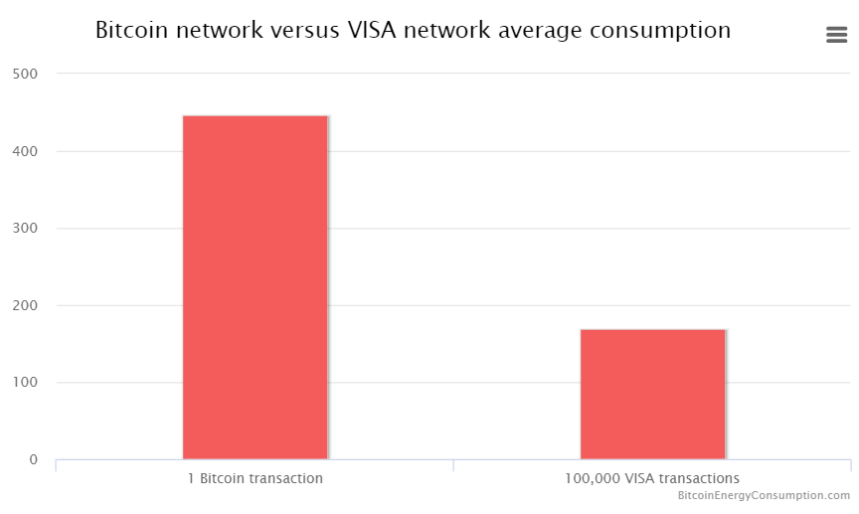
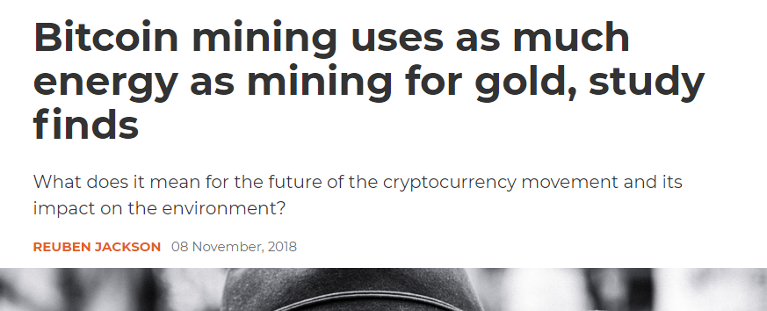
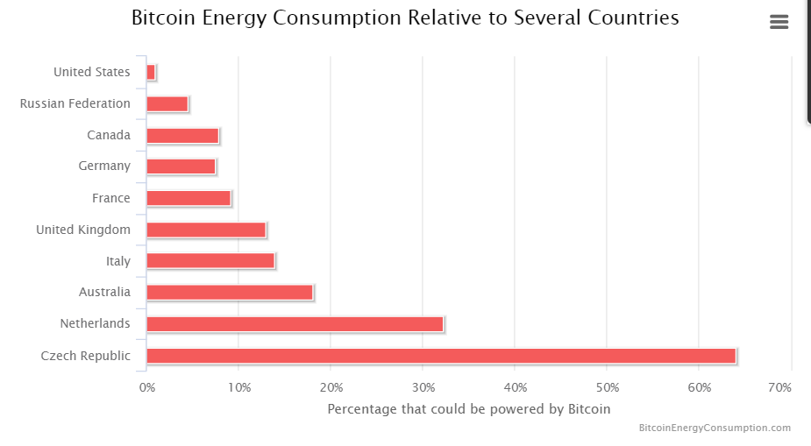
Wasteful

Slide 53
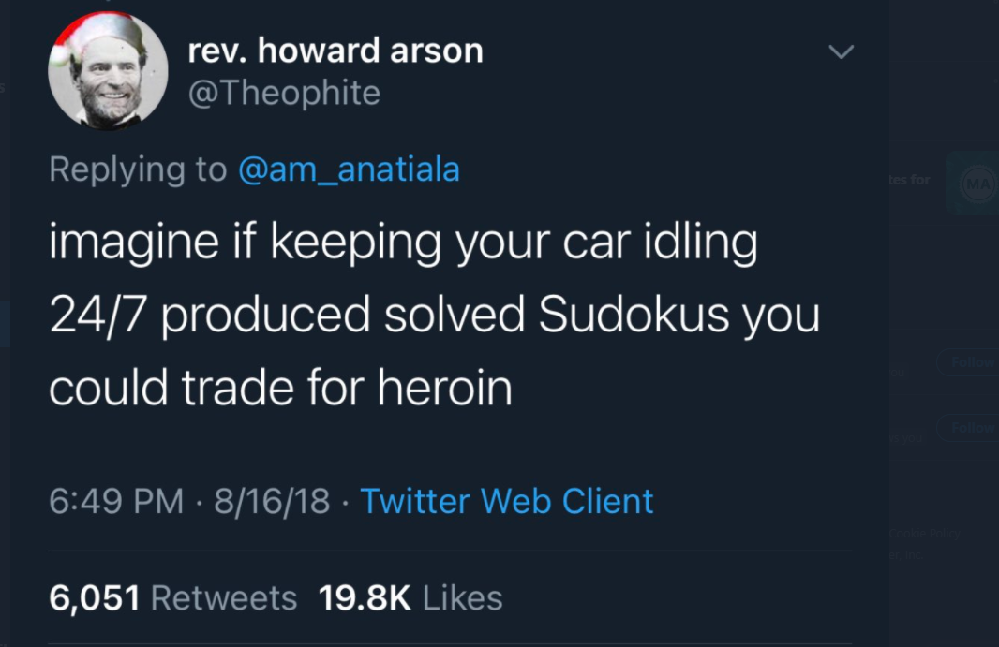

Slide 54
Trigger Warning:
Opinions

Slide 55
Classic, well-written paper.
But we can’t read it like it’s still 2008
Like the Communist Manifesto, things didn’t turn out quite as expected …
Notes:
Bitcoin, Ethereum, ICOs, blockchains, etc. are the result of a single paper (and running code) that appeared mysteriously in 2008. I am going to claim it’s all about distributed computing, but it did not come from the distributed computing research community. I feel confident speculating that if this paper had been submitted to PODC in 2008, it would have been rejected for defining consensus weirdly, or not proving any lemmas, or not providing experiments. Yet here we are, looking at a new, vibrant, and active area of CS. What are we to make of it?

Slide 56
Motivation
Commerce on the internet == credit cards
Problem: credit card transactions are reversible
NB: only a problem from merchant’s PoV

Slide 57

Motivation
Credit Cards = friction & inefficiency
Card companies must decide whom to trust, so they spy on you for credit scores

Slide 58
Nakamoto saw bitcoin as a credit card replacement for Internet commerce!

Slide 59
Motivation
Irreversible charges protect merchants
(Consumers don’t deserve protection?)
No recourse for theft, fraud, …

Slide 60
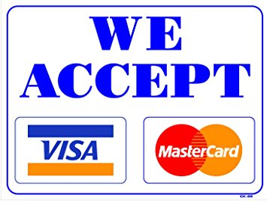
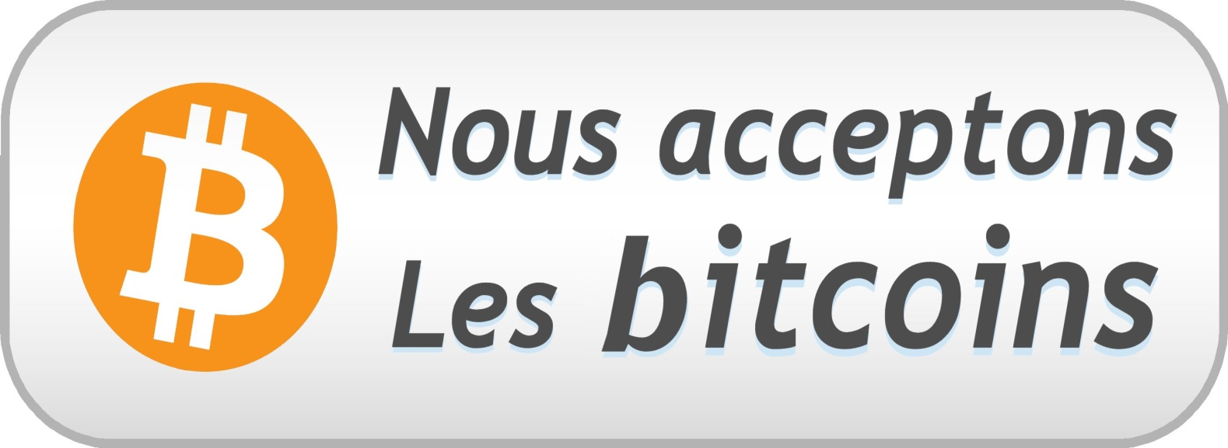
“Would you be willing to give up your miles in return for never being able to dispute a transaction?”
One-sided protection for merchants, none for consumers.
Oh, did someone steal your secret keys?
(In Libertarian Paradise, Bitcoin spends you.)

Slide 61
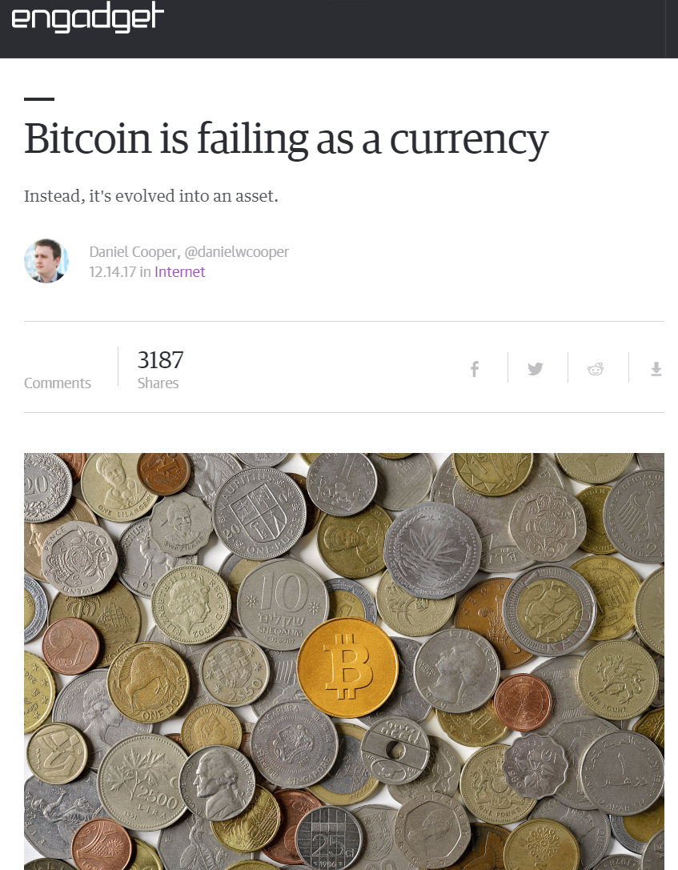
Money serves two purposes:
Medium of exchange (buy beer)
store of value
(keep under mattress)
61

Slide 62
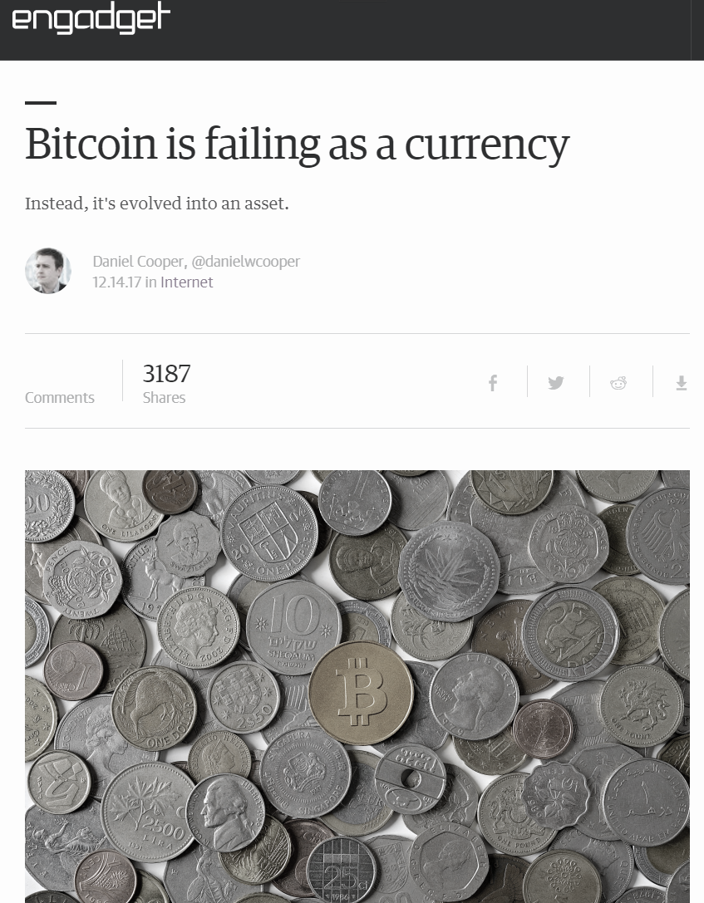
Money serves two purposes:
Medium of exchange (buy pizza)
store of value
(keep under mattress)
Crazy Success (until it isn’t)
62

Slide 63
Money serves two purposes:
Medium of exchange (buy pizza)
store of value
(keep under mattress)
Not so much.
63

Slide 64
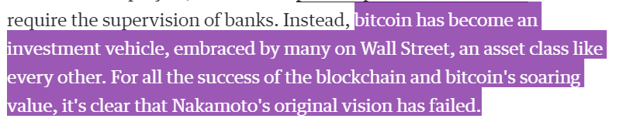
Would Nakamoto recognize today’s Bitcoin?
Nakamoto’s vision: BTC as (one-sided) credit card replacement on internet.
He never anticipated only actual use: speculation

Slide 65
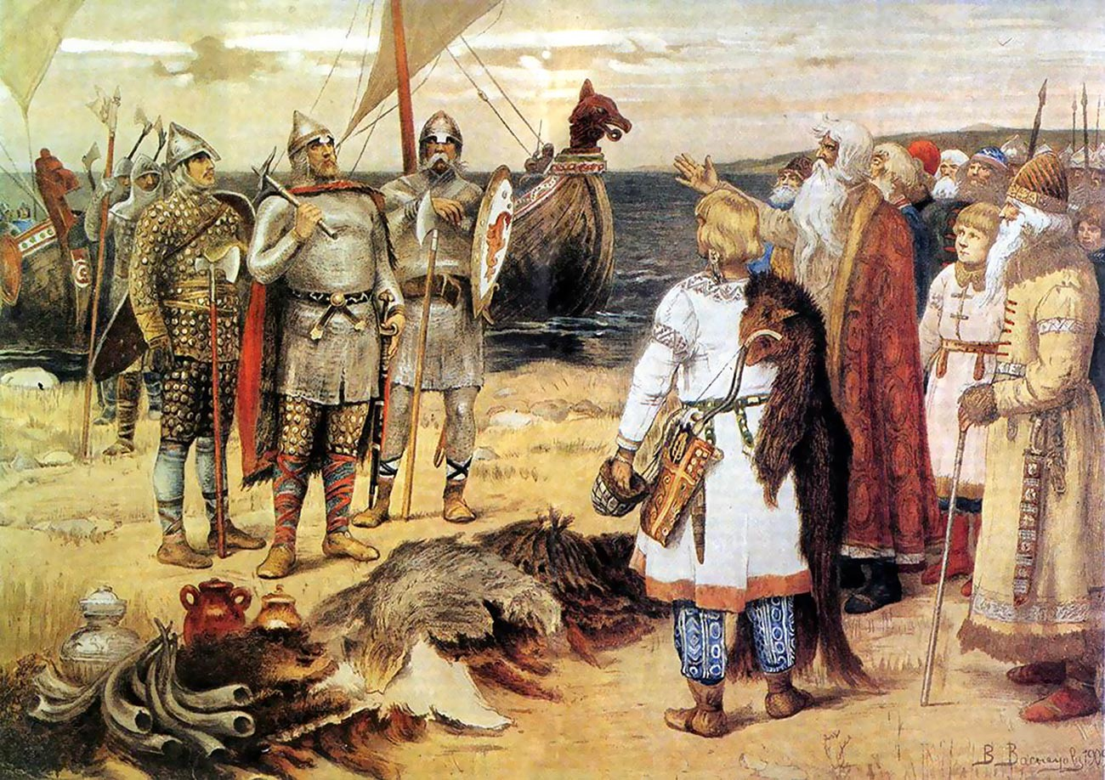
Mutual benefit if we co-operate
But we don’t trust each other
Can’t sue in court
Not a New Problem

Slide 66

Number go up
Why should I spend coins worth more tomorrow?
Why should I take coins worth less tomorrow?
Number go down
Buyer
Seller

Slide 67
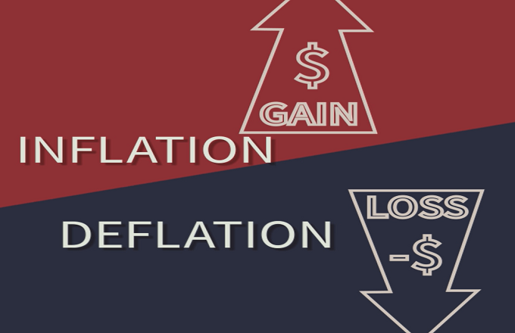
Nakamoto feared inflation ….
But deflationary economies depressed because rational players don’t spend money

Slide 68
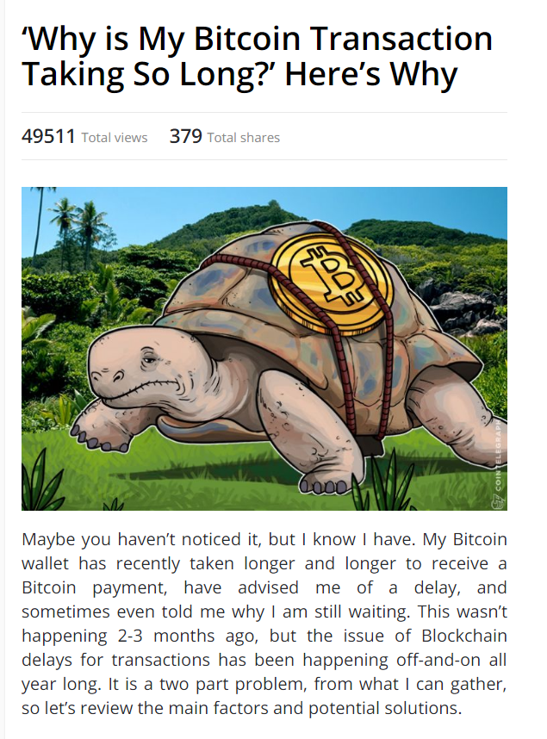
Problem Long or Unpredictable Completion Times

Slide 69
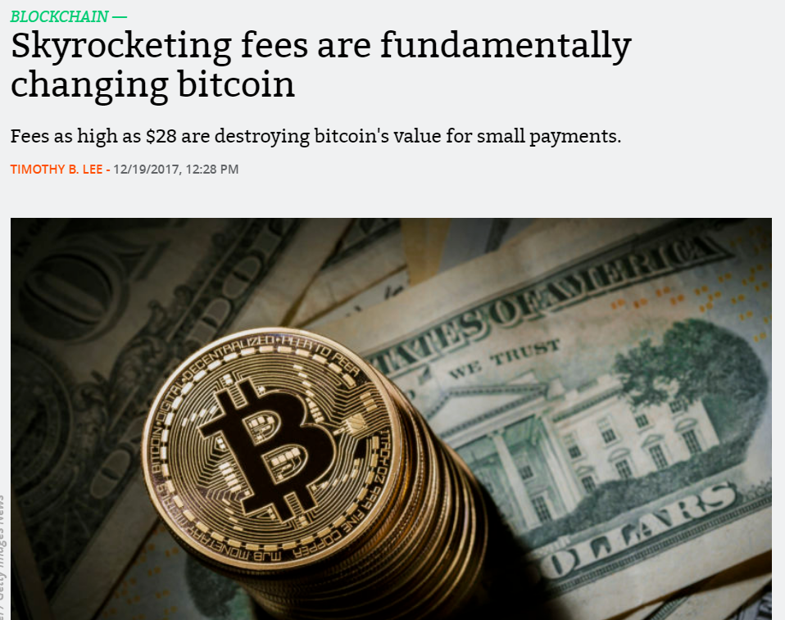
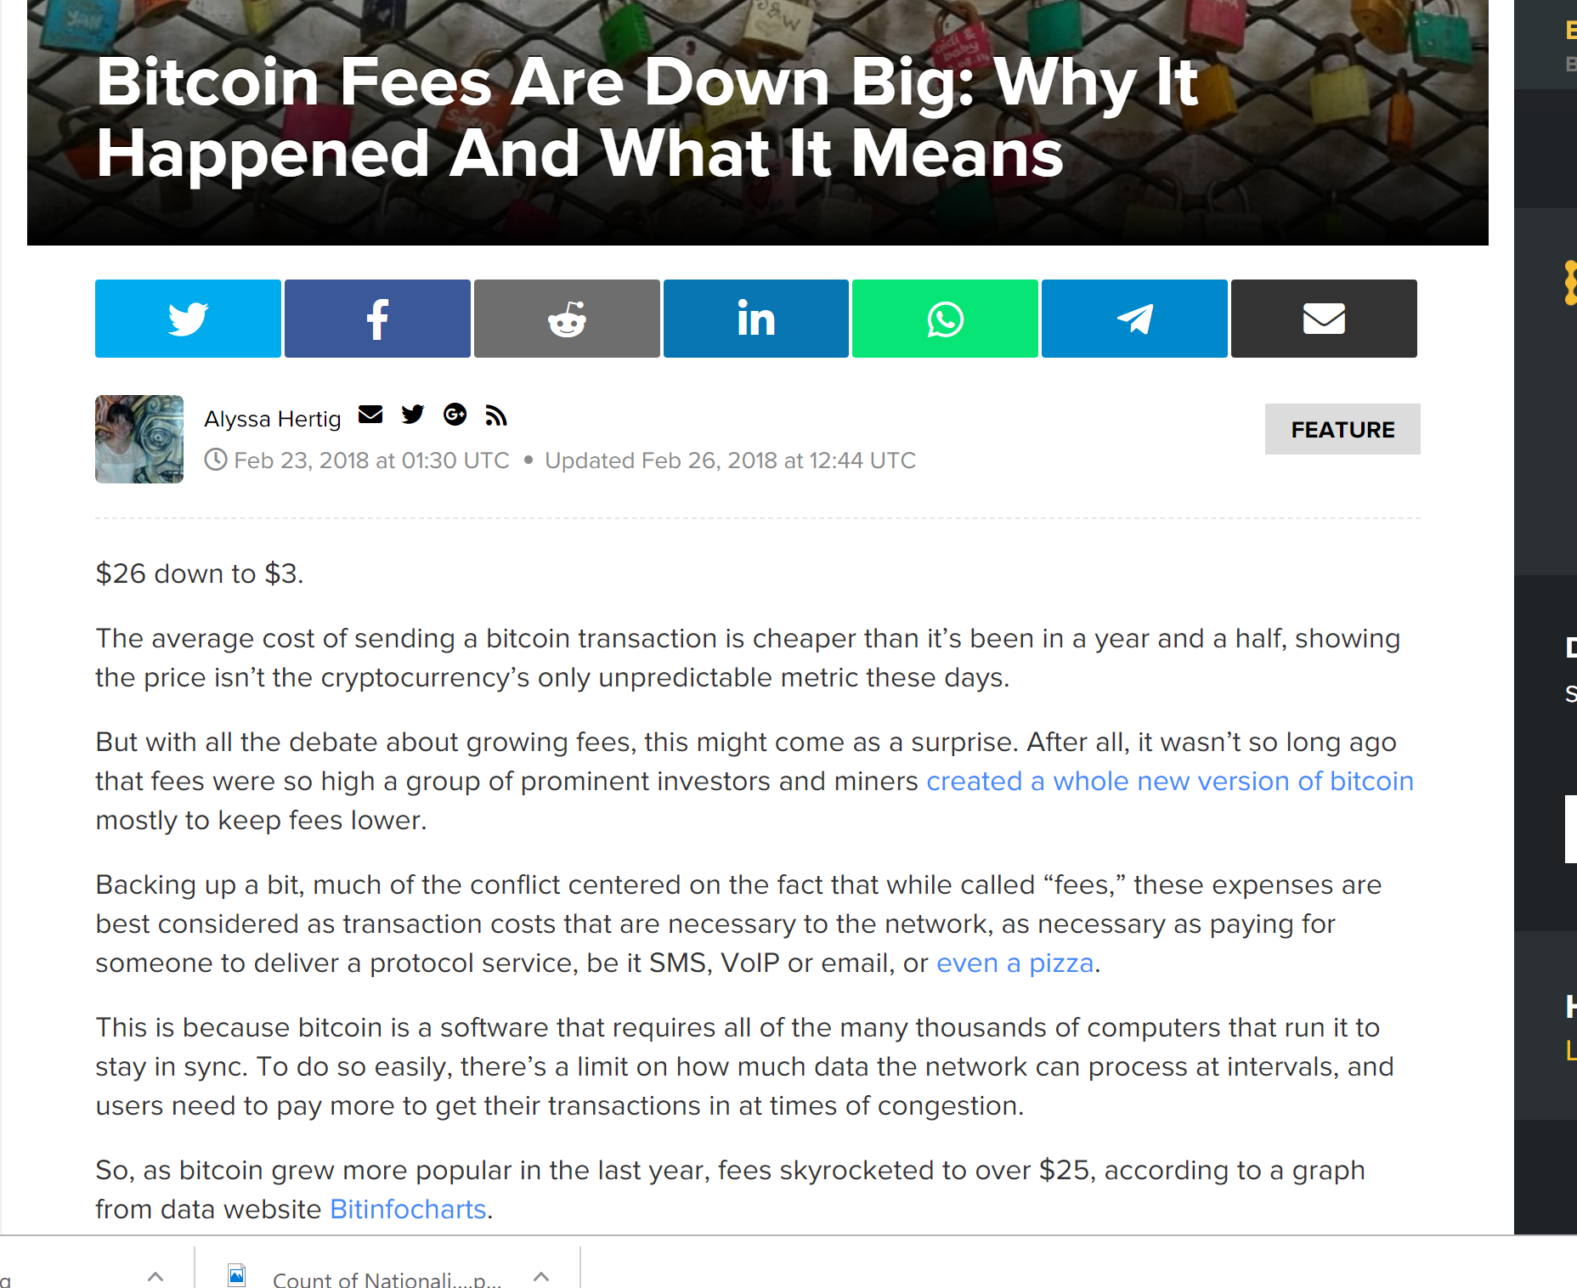
Problem: Fee Volatility

Slide 70
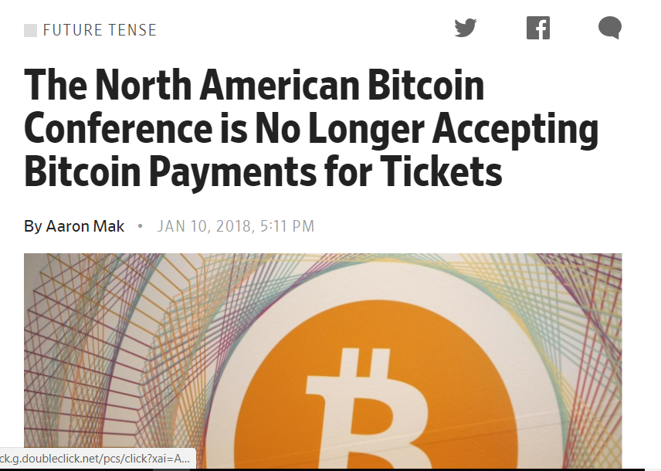
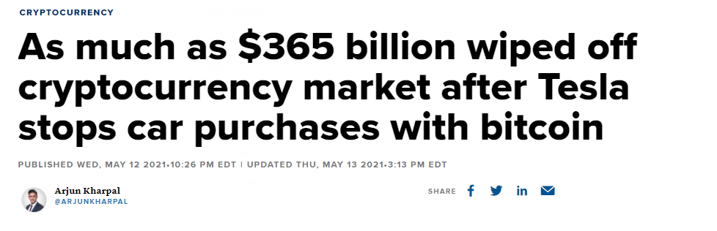
Convenience vs Ideology

Slide 71
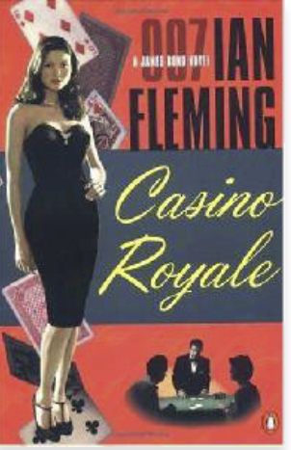
Bitcoin Investing is like a casino …
Must buy chips to play …
But the house won’t buy them back …
Can only sell to incoming players ….
Works only as long as money in ≥ money out

Slide 72

“You can leave any time you like, but you might not be able to check out”
(This is not investment advice)

Slide 73
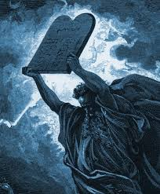
Bitcoin Governance Theory
Canonicalism:
All and only what Satoshi revealed is permitted
Appealing to the faithful …
But fails to explain upgrades …
… and bug fixes.

Slide 74
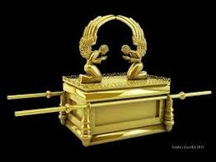
Actual Governance?
De facto governance by …
“Core Bitcoin Devs”
Commit access to bitcoind
Supported by the Bitcoin Foundation
Controversy wrt block sizes, etc.

Slide 75
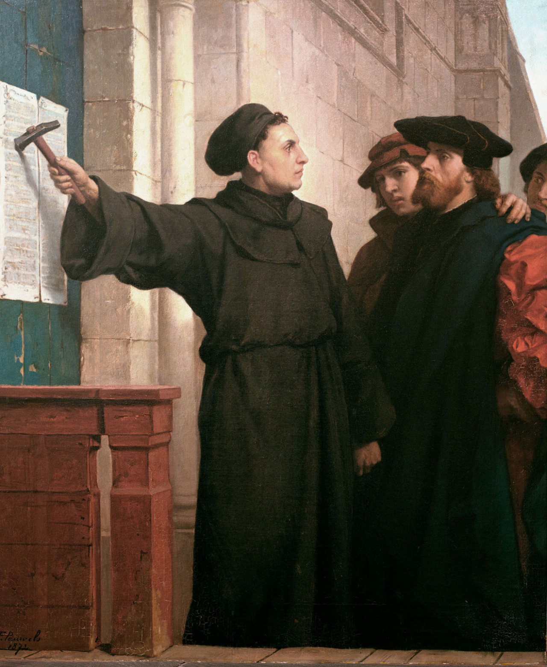
Ideas we covered in this lecture
BTC Blockchain is linked list of blocks
Block is sequence of transactions
Transaction = UTXO
Use of hashes and signatures
Incentives for miners
Economic incentives

Slide 76
